Slide 1


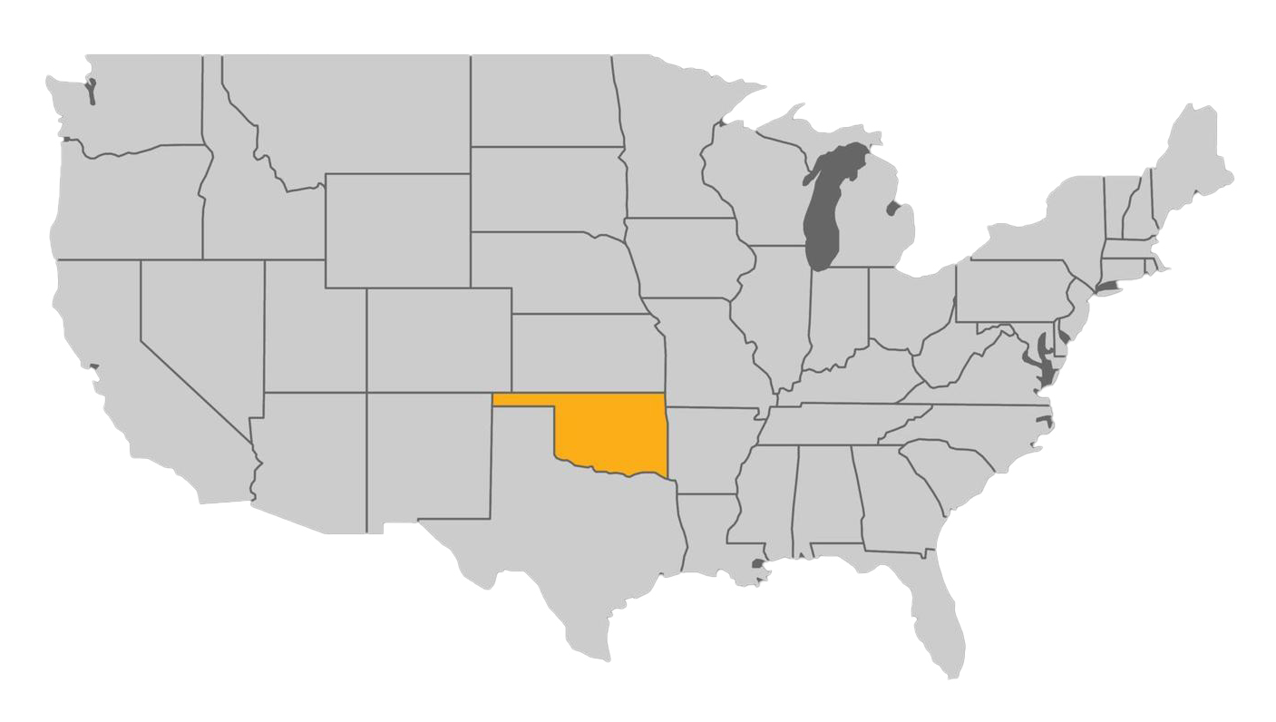
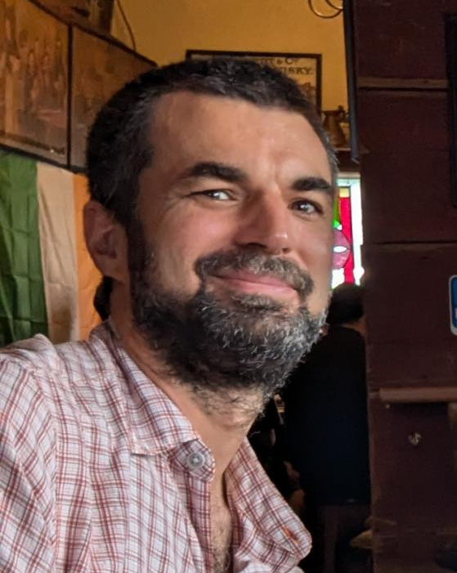



Christian K. Bach
University: Oklahoma State University
Study program: Mechanical and Aerospace Engineering
Year of study: 20+, still learning!
City: Stillwater, Oklahoma, USA
Motto for life: Try to take care of this place for future generations.
Hobbies: 3+ year old kid, Stihl/Echo power toys, planting trees, fishing, …
Your expectations for the summer school: Provide a new perspective to some of you and be exposed to your perspectives!
Location
Alumnus Dipl.-Ing. (FH) 2008

